Slide 1
SPIN: Part 2
15-414/614 Bug Catching: Automated Program Verification
Sagar Chaki
April 21, 2014
Notes:
Title Slide
Title and Subtitle text blocks should not be moved from their position if at all possible.

Slide 2
Control flow
We have already seen some
Concatenation of statements, parallel execution, atomic sequences
There are a few more
Case selection, repetition, unconditional jumps

Slide 3

Case selection
$$if$$
$$:: \left(a < b\right)→option1$$
$$:: \left(a > b\right)→option2$$
$$:: else→option3 /∗ optional ∗/$$
$$fi$$
Cases need not be exhaustive or mutually exclusive
Non-deterministic selection

Slide 4
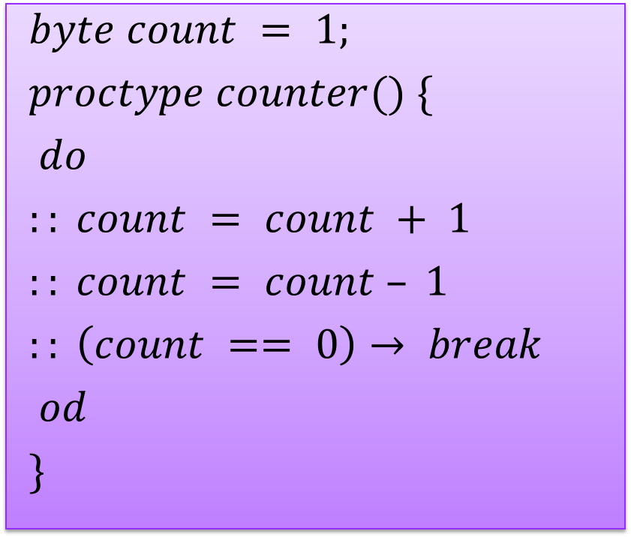
Repetition
$$byte count = 1;$$
$$proctype counter() \{$$
$$do$$
$$:: count = count + 1$$
$$:: count = count – 1$$
$$:: \left(count == 0\right)→ break$$
$$od$$
$$\}$$

Slide 5
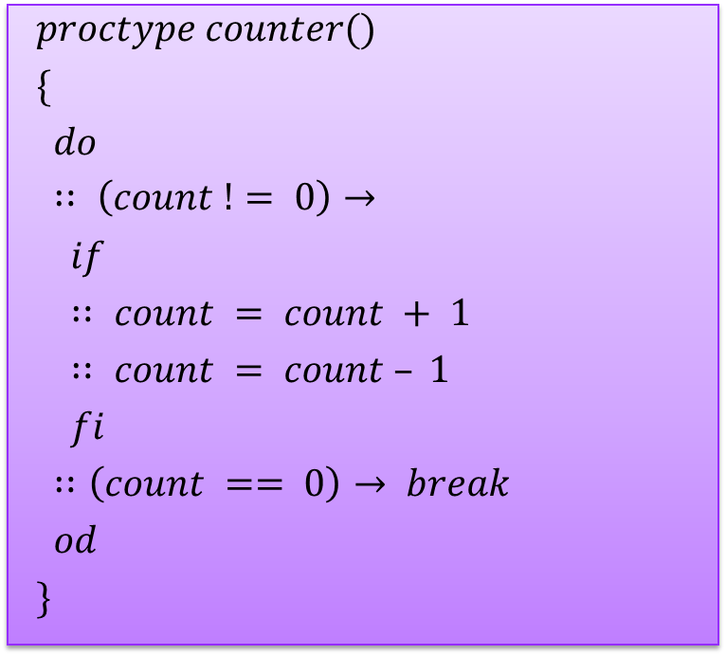
Repetition
$$proctype counter()$$
$$\{$$
$$do$$
$$∷ \left(count != 0\right)→$$
$$if$$
$$∷ count = count + 1$$
$$∷ count = count – 1$$
$$fi$$
$$∷\left(count == 0\right)→ break$$
$$od$$
$$\}$$

Slide 6
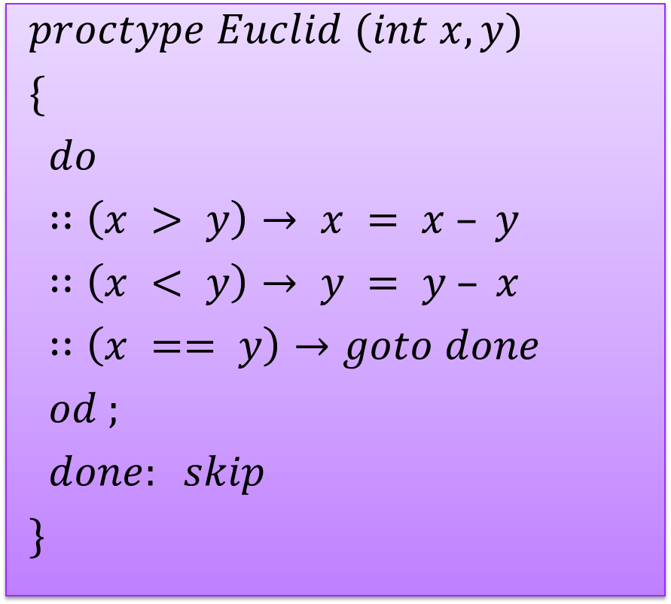
Unconditional jumps
$$proctype Euclid (int x, y)$$
$$\{$$
$$do$$
$$∷\left(x > y\right)→ x = x – y$$
$$∷\left(x < y\right)→ y = y – x$$
$$∷\left(x == y\right)→goto done$$
$$od ;$$
$$done: skip$$
$$\}$$

Slide 7
Procedures and Recursion
Procedures can be modeled as processes
Even recursive ones
Return values can be passed back to the calling process via a global variable or a message

Slide 8
Time for example 3

Slide 9
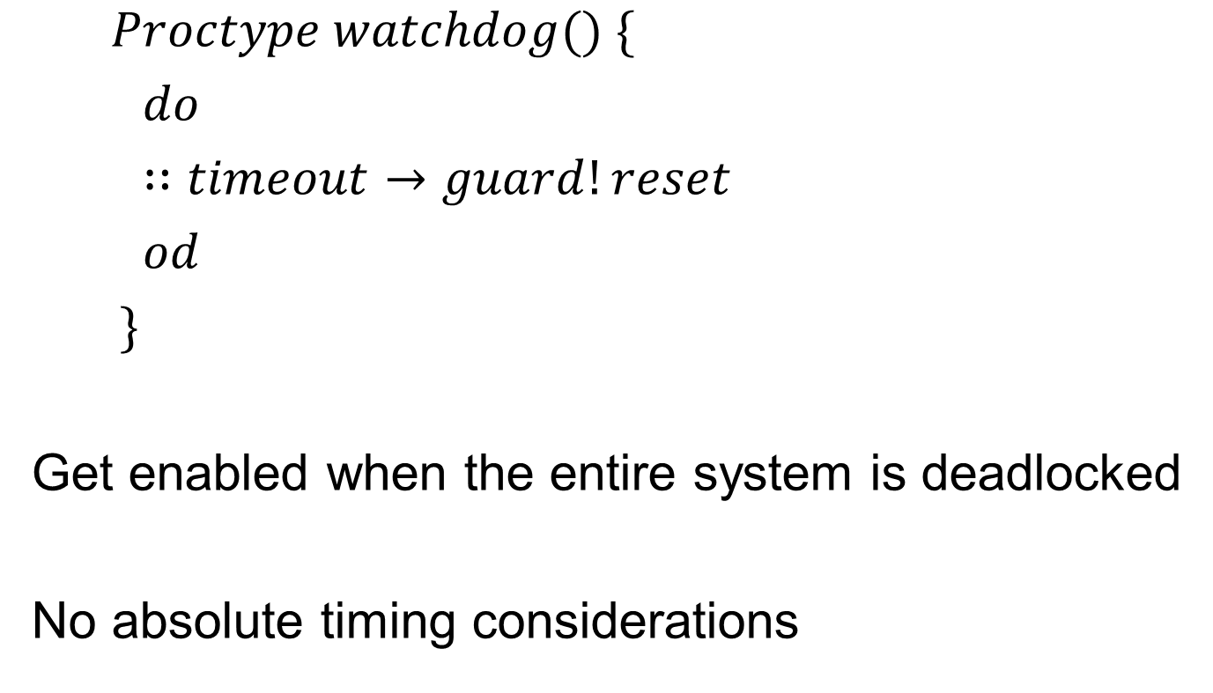
Timeouts
$$Proctype watchdog() \{$$
$$do$$
$$∷timeout→guard!reset$$
$$od$$
$$\}$$
Get enabled when the entire system is deadlocked
No absolute timing considerations

Slide 10

Assertions
$$assert(any_boolean_condition)$$
pure expression
If condition holds ) no effect
If condition does not hold ) error report during verification with Spin

Slide 11
Time for example 4

Slide 12
LTL model checking
Two ways to do it
Convert Kripke to Buchi
Convert claim (LTL) to Buchi
Check language inclusion
OR
Convert ~Claim (LTL) to Buchi
Check empty intersection

Slide 13
What Spin does
Checks non-empty intersection
Requires very little space in best case
Works directly with Promela
No conversion to Kripke or Buchi
Must provide Spin with negation of property you want to prove

Slide 14
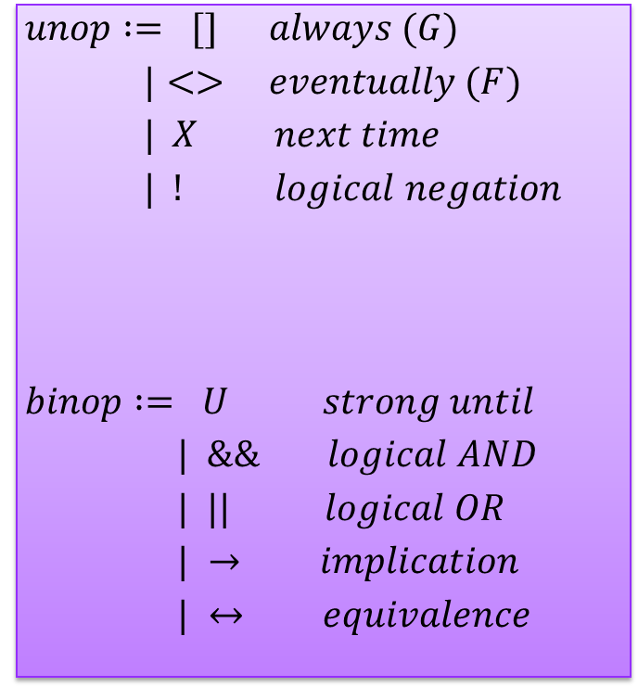
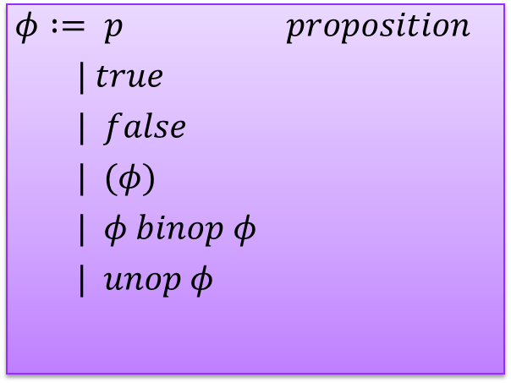
LTL syntax in SPIN
$$unop := [] always (G)$$
$$|<> eventually (F)$$
$$| X next time$$
$$| ! logical negation$$
$$binop := U strong until$$
$$| \&\& logical AND$$
$$| || logical OR$$
$$| → implication$$
$$| ↔ equivalence$$
$$φ := p proposition$$
$$| true$$
$$| false$$
$$| (φ)$$
$$| φ binop φ$$
$$| unop φ$$

Slide 15
Time for example 5

Slide 16
Peterson’s Algorithm in SPIN
Active process:
automatically creates instances of processes
bool turn, flag[2];
active [2] proctype user()
{
assert(_pid == 0 || _pid == 1);
again:
flag[_pid] = 1;
turn = _pid;
(flag[1 - _pid] == 0 || turn == 1 - _pid);
/* critical section */
flag[_pid] = 0;
goto again;
}
_pid:
Identifier of the process
assert:
Checks that there are only
at most two instances with
identifiers 0 and 1

Slide 17
Peterson’s Algorithm in SPIN
bool turn, flag[2];
byte ncrit;
active [2] proctype user()
{
assert(_pid == 0 || _pid == 1);
again:
flag[_pid] = 1;
turn = _pid;
(flag[1 - _pid] == 0 || turn == 1 - _pid);
ncrit++;
assert(ncrit == 1); /* critical section */
ncrit--;
flag[_pid] = 0;
goto again;
}
ncrit:
Counts the number of
Process in the critical section
assert:
Checks that there are always
at most one process in the
critical section

Slide 18
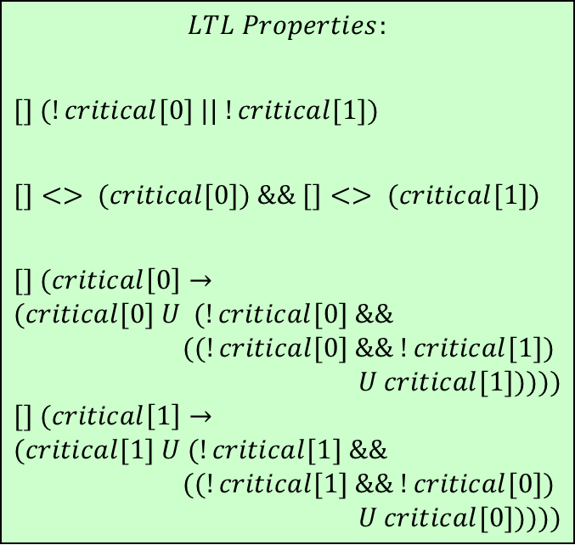
Peterson’s Algorithm in SPIN
Use a pair of flags instead of a count
bool turn, flag[2];
bool critical[2];
active [2] proctype user()
{
assert(_pid == 0 || _pid == 1);
again:
flag[_pid] = 1;
turn = _pid;
(flag[1 - _pid] == 0 || turn == 1 - _pid);
critical[_pid] = 1;
/* critical section */
critical[_pid] = 0;
flag[_pid] = 0;
goto again;
}
$$LTL Properties:$$
$$[] (!critical[0] || !critical[1])$$
$$[]<> (critical[0]) \&\& []<> (critical[1])$$
$$[] (critical\left[0\right]→$$
$$(critical[0] U (!critical[0] \&\&$$
$$((!critical[0] \&\& !critical[1])$$
$$U critical[1]))))$$
$$[] (critical\left[1\right]→$$
$$(critical[1] U (!critical[1] \&\&$$
$$((!critical[1] \&\& !critical[0])$$
$$U critical[0]))))$$
mutex
no starvation
alternation
alternation

Slide 19
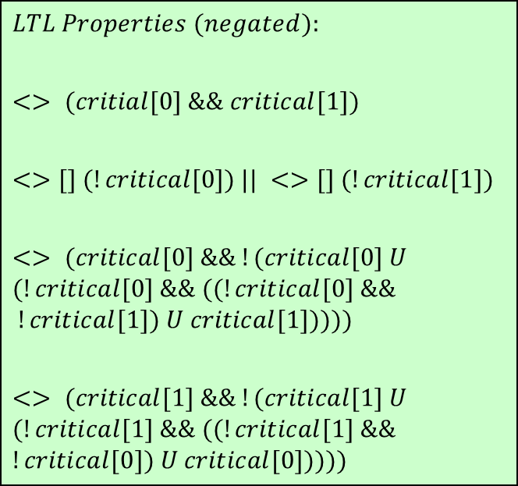
Peterson’s Algorithm in SPIN
bool turn, flag[2];
bool critical[2];
active [2] proctype user()
{
assert(_pid == 0 || _pid == 1);
again:
flag[_pid] = 1;
turn = _pid;
(flag[1 - _pid] == 0 || turn == 1 - _pid);
critical[_pid] = 1;
/* critical section */
critical[_pid] = 0;
flag[_pid] = 0;
goto again;
}
holds
$$LTL Properties (negated):$$
$$<> (critial[0] \&\& critical[1])$$
$$<>[] (!critical[0]) || <>[] (!critical[1])$$
$$<> (critical[0] \&\& !(critical[0] U$$
$$(!critical[0] \&\& ((!critical[0] \&\&$$
$$!critical[1]) U critical[1]))))$$
$$<> (critical[1] \&\& !(critical[1] U$$
$$(!critical[1] \&\& ((!critical[1] \&\&$$
$$!critical[0]) U critical[0]))))$$
holds
does not hold
does not hold

Slide 20
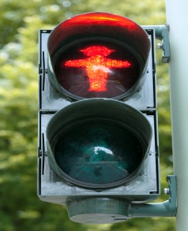
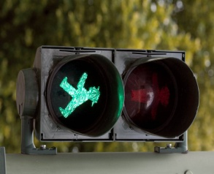
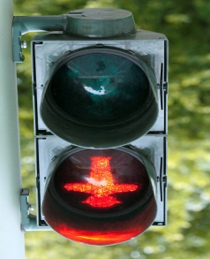
N
Traffic Controller
W
S

Slide 21
Modeling in SPIN
System
No turning allowed
Traffic either flows East-West or North-South
Traffic Sensors in each direction to detect waiting vehicles
Traffic.pml
Properties:
Safety : no collision (traffic1.ltl)
Progress – each waiting car eventually gets to go (traffic2.ltl)
Optimality – light only turns green if there is traffic (traffic3.ltl)

Slide 22
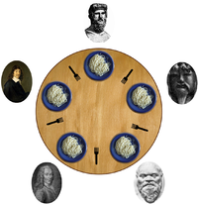
Dining Philosophers

Slide 23
Modeling in SPIN
Each fork is a rendezvous channel
A philosopher picks up a fork by sending a message to the fork.
A philosopher releases a fork by receiving a message from the fork.
Properties
No deadlock
Safety – two adjacent philosophers never eat at the same time – dp0.ltl
No livelock – dp1.ltl
No starvation – dp2.ltl
Versions
dp.pml – deadlock, livelock and starvation
dp_no_deadlock1.pml – livelock and starvation
dp_no_deadlock2.pml – starvation

Slide 24
References
http://cm.bell-labs.com/cm/cs/what/spin/
http://cm.bell-labs.com/cm/cs/what/spin/Man/Manual.html
http://cm.bell-labs.com/cm/cs/what/spin/Man/Quick.html

Slide 25
Questions?
Sagar Chaki Senior Member of Technical Staff RTSS Program Telephone: +1 412-268-1436 Email: chaki@sei.cmu.edu | U.S. Mail Software Engineering Institute Customer Relations 4500 Fifth Avenue Pittsburgh, PA 15213-2612 USA
Web www.sei.cmu.edu/staff/chaki | Customer Relations Email: info@sei.cmu.edu Telephone: +1 412-268-5800 SEI Phone: +1 412-268-5800 SEI Fax: +1 412-268-6257

